Slide 1

Exceed Presentation
Title of Idea
Automatic Plant Moisture Monitoring System
S.NO | Name of the student | Roll No. | Branch
1 | G SRUJANKUMAR | 20951A3353 | CSIT
22 | P SUMANTH | 20951A3354 | CSIT

Slide 2
PROBLEM STATEMENT
Who are your customers? Whose problem you are solving ?
Our main customers are the farmers and plant care takers. We solve the moisture problem of plant with our model.
What is the job that the customer is trying to get done?
The main job of customer is monitor the plant and should have electricity backup. And should monitor the plant how the growth of the plant day by day.
Is the Problem Big Enough?
Yes our model keeps plant healthy and it is very useful to farmers and plant caretakers.

Slide 3
PROPOSED SOLUTION
What is the solution ?
This system timely monitors the moisture level of the soil. If at the time of monitoring it comes to know that the moisture level of the soil is lower than recommended then it will automatically starts water pump. water pump.
How it can be used ?
In this system we use A moisture level sensor is used to detect the moisture level of the soil. And we use Arduino and relay module and we have program it to on/off the water pump automatically through relay module.

Slide 4
PROOF OF CONCEPT/PROTOTYPE DETAILS
Which technologies are being used ?
Hardware Specifications :
Arduino UNO
5 Volt Relay Module
Soil Moisture Sensor
Jumper Wires
Water Pump and tube/pipe
Software Specifications :
Arduino Idle.

Slide 5
PROOF OF CONCEPT/PROTOTYPE DETAILS
Program to Arduino:
int water; //random variable
void setup() {
pinMode(3,OUTPUT); //output pin for relay board, this will sent signal to the relay
pinMode(6,INPUT); //input pin coming from soil sensor
} void loop() {
water = digitalRead(6); // reading the coming signal from the soil sensor
if(water == HIGH) // if water level is full then cut therelay
{
digitalWrite(3,LOW); // low is to cut the relay
}
else
{
digitalWrite(3,HIGH);}
delay(400);
}

Slide 6
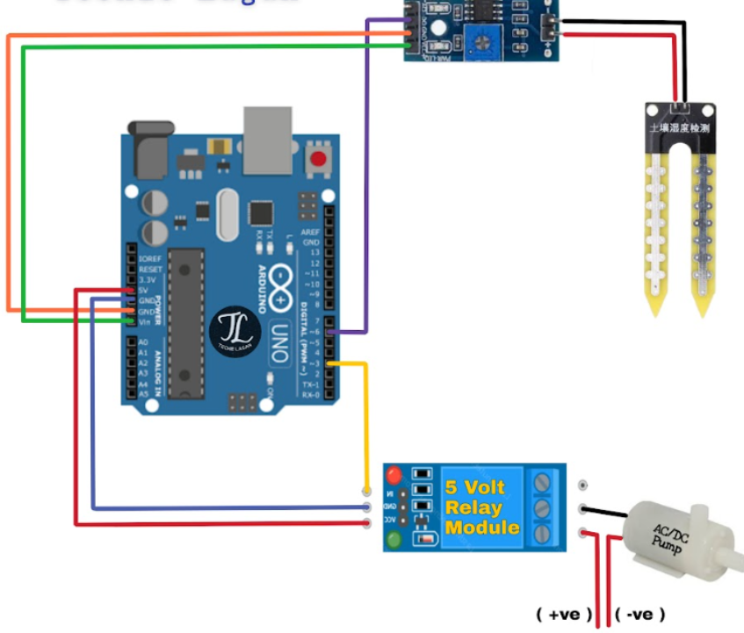
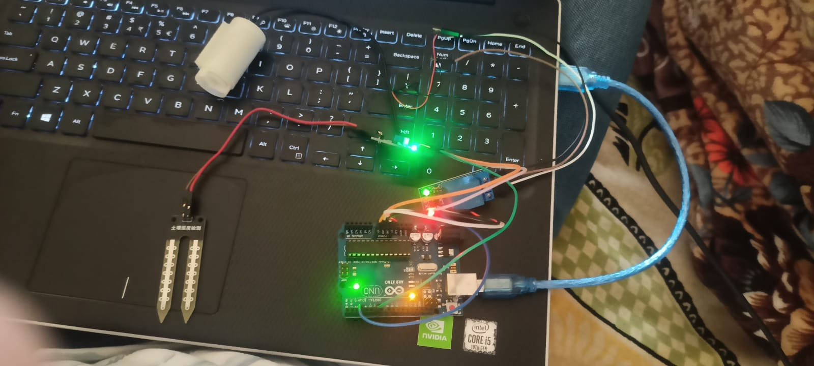
PROOF OF CONCEPT/PROTOTYPE DETAILS
Any proof of concept or prototype developed ?

Slide 7
VALUE PROPOSITION
What is better about your solution than the existing solutions ?
In this system we use A moisture level sensor is used to detect the moisture level of the soil. And we use Arduino and relay module and we have program it to on/off the water pump automatically through relay module.
How is your product making your customer happy ?
As the system is automated and it costs low with Arduino .It is very useful to the farmers and it costs around 2000 in Indian currency and it is automated.

Slide 8
COMPETITION
Any existing solutions in the market ?
Yes there exits a solution in the market. But we have enhanced and added some components to the existing project

Slide 9
THANK YOU

